Slide 1


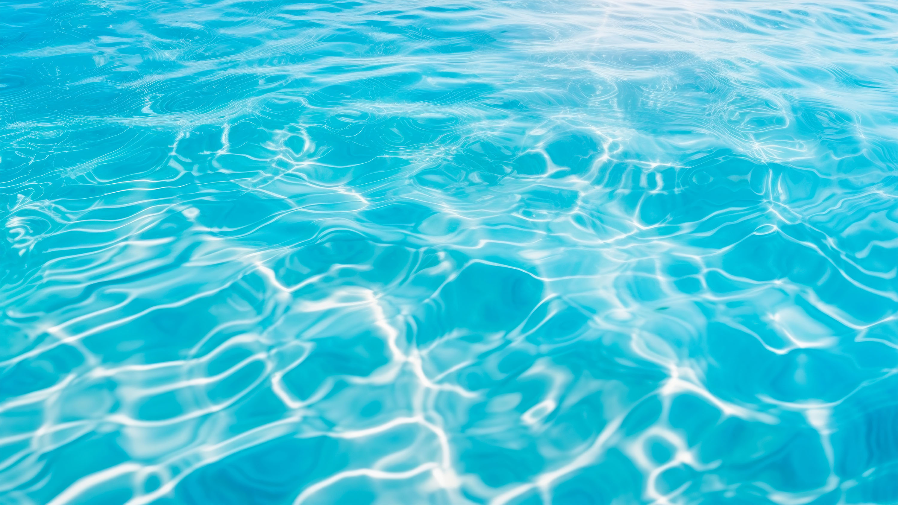

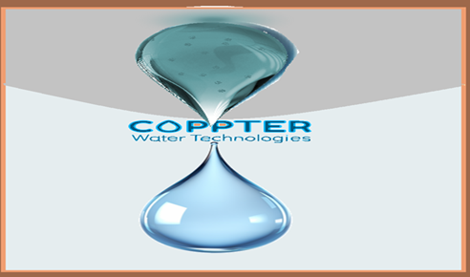

Scientific
A new era
of environmentally friendly& chlorine-free Safe Water
www.coppter.co.il
magal@coppter.co.il

Slide 2



Main disinfection agent - Chlorine
CHLORINE - A SERIOUS HAZARD

Slide 3
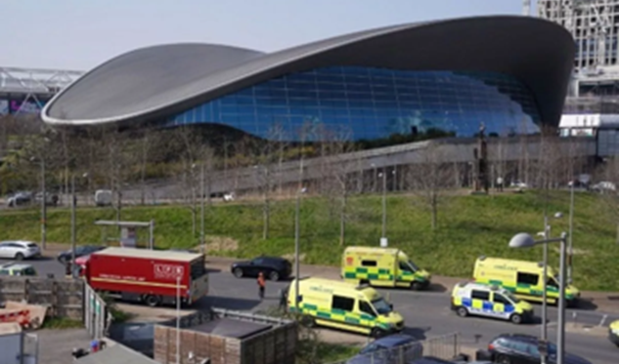

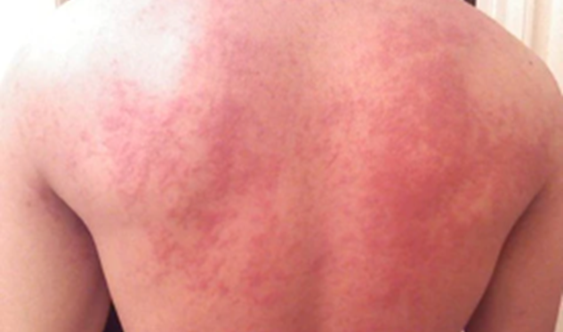

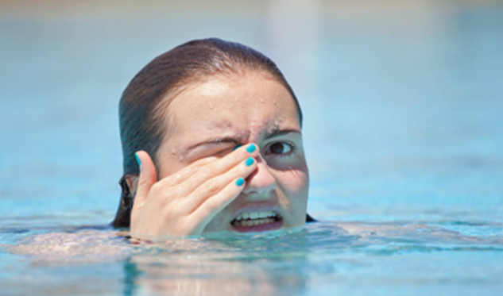
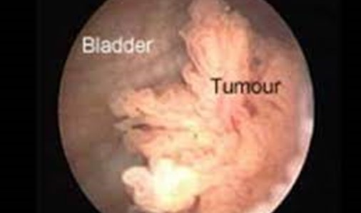
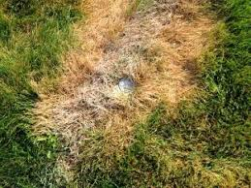
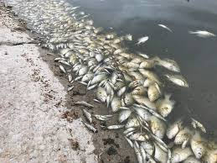
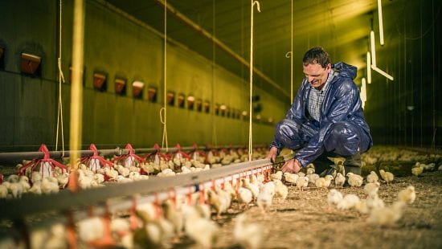
CHLORINE - A SERIOUS HAZARD
Current Chlorine alternative – not sufficient
CHLORINE GAS IS FATAL
CHLORINE + URINE = CANCER
SKIN IRRITATION
BURNING EYES
Not suitable for aquaculture
Not suitable for most types of agriculture
Not suitable for animal farming

Slide 4
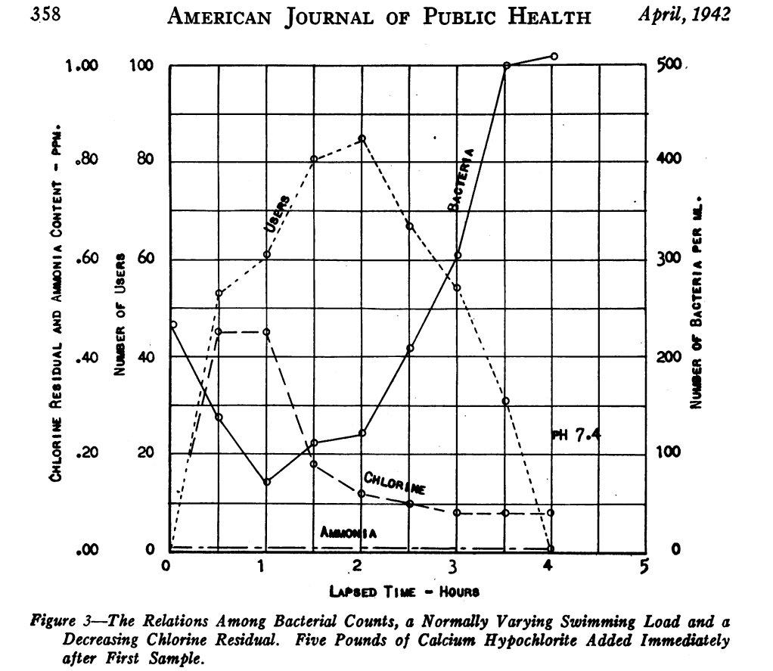

חממת InNegev
Number of bathers versus amount of bacteria
From an article from 1942 that is a landmark on the subject of pool water disinfection: When the number of bathers is large, the amount of bacteria increases. Chlorine at a concentration of 0.45ppm reduces the amount of bacteria from 240 bacteria/ml to 75 bacteria/ml within an hour.
The system offered by us is mtuch more effective than chlorine.

Slide 5
The Holy Grail - Chlorine-Free Bathwater
Chlorine, as a purification agent, has been used for Bathwater treatment since the early 1900s
Consumers are seeking an effective alternative
Water Disinfection Treatments

Slide 6

Coppter developed a safe water treatment
using a unique form of copper (Cu⁺)
as a disinfectant

Slide 7
Scientific background
Copper :
Since the dawn of time, mankind has been using various copper phase to prevent various infections caused by a wide array of harmful microorganisms. Nowadays it’s not a common in antimicrobial products. Perhaps because of the absence of repeatability of its effect.
Our research has shown that the only form of copper (Cu) to have the desirable effect is monovalent copper (Cu⁺) and furthermore that it can be continuously generated by alternation of the local conditions of the site, thus allowing us to achieve a vigorous repeatable effect*.
Magal saphier, Eldad Silberstein, Yoram Shotland, Stanislav Popov and Oshra Saphier, "Prevalence of Monovalent Copper Over Divalent in Killing Escherichia coli and Staphylococcus aureus" Current Microbiology, https://doi.org/10.1007/s00284-017-1398-4, 2017
Stanislav Popov, Oshra Saphier, Mary Popov, Marina Shenker, Semion Entus, Yoram Shotland and Magal Saphier; "Factors Enhancing the Antibacterial Efect of Monovalent Copper Ions", Current Microbiology, December 2019,p 1-8 , https://link.springer.com/article/10.1007/s00284-019-01794-6 2019.

Slide 8
Scientific background
monovalent copper Cu⁺
The antimicrobial to date; this is due to the low stability of monovalent copper ions in aqueous solutions, which led to the assumption that their concentration is negligible in biological systems.
In aqueous solutions, the common oxidation state of copper ions is bivalent (Cu²⁺, cupric).
Copper in the monovalent state (Cu⁺, cuprous) remains in a low concentration due to a disproportion reaction (self-oxidation of monovalent copper to divalent copper and metallic copper), and due to rapid oxidation by molecular oxygen to divalent copper.
2 Cu⁺_{(aq)} Cu⁺² + Cu⁰ K_{eq}= 5.38 X 10⁵

Slide 9
Scientific background
Cu⁺ antimicrobial effect :
Our research has shown that the only form of copper (Cu) to have the desirable effect is monovalent copper (Cu⁺) , and that it can be continuously generated by alternation of the local site conditions, thus allowing us to achieve a vigorous, repeatable effect.

Slide 10
Scientific background
Effect of Elevated Temperatures on Antibacterial Activity of Monovalent copper Ions
Viable cell count of E. coli bacteria (log10 cfu/ml) over temperature after 1 min incubation in anaerobic conditions

Slide 11
Scientific background
Water disinfection
The presence of monovalent copper ions lowers the amount of E. Coli from 10,000 bacteria per cm³ to 0 (room atmosphere)
The relation between CFU (number of bacteria in ml solution, log4=10000 bac/ml) of E. Coli bacteria in contaminated water and time from applying generation of monovalent copper ions at different temperatures.

Slide 12
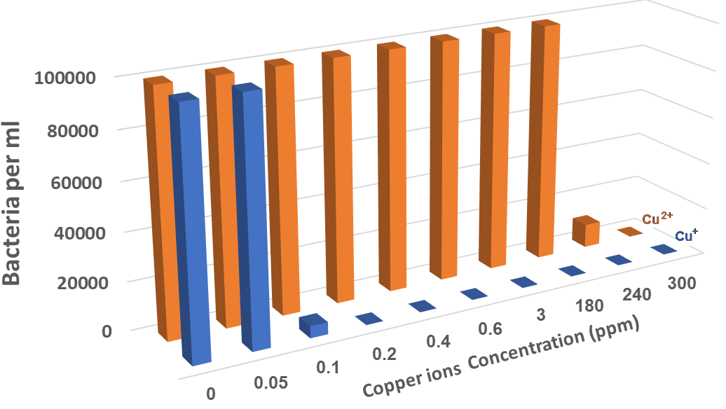
COPPTER’S TECHNOLOGY
Cu regulation in drinking water:
Europe: up to 2 PPM
The US: up to 1.4 PPM
Safe water treatment using a unique form of copper ion (Cu⁺) In low concentrations of 0.2 PPM as a disinfectant
While
You need to use over 300 PPM of Cu ²⁺ to have the same effect!

Slide 13
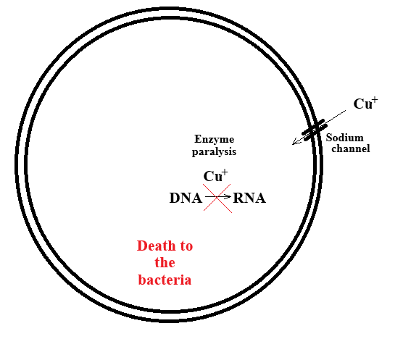
Scientific background
How It Works: Cu⁺ Disinfection
The mechanism involves the entry of monovalent copper ions into the bacterial Cytoplasm, which causes irreversible enzyme inhibition in the cell.
It has been found that monovalent copper ion inhibits the activity of the enzyme DNA polymerase and similar enzymes*.
It was found that blocking the bacteria's sodium channels allows them to survive in the presence of monovalent copper ions.
Magal Saphier, Lea Moshkovich, Stanislav Popov, Yoram Shotland, Eldad Silberstein and Oshra Saphier; Monovalent Copper Ions Inhibit Enzymatic Systems J Appl Microb Res earch, Volume 5: 2 ISSN: 2581-7566, 2022

Slide 14
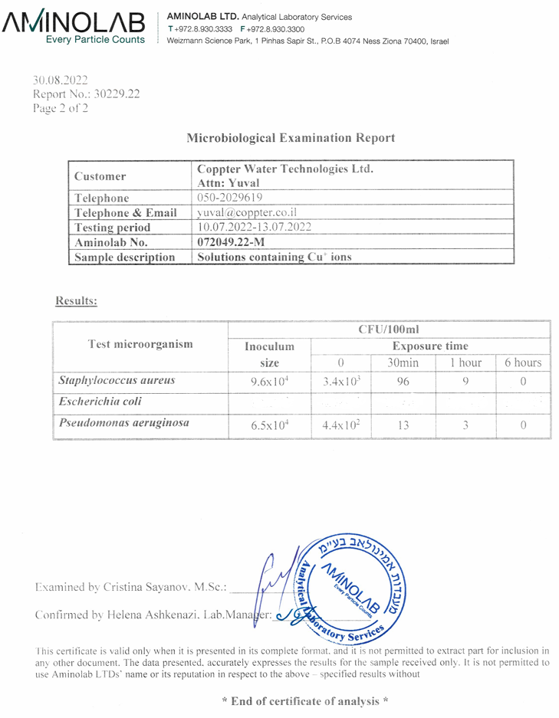
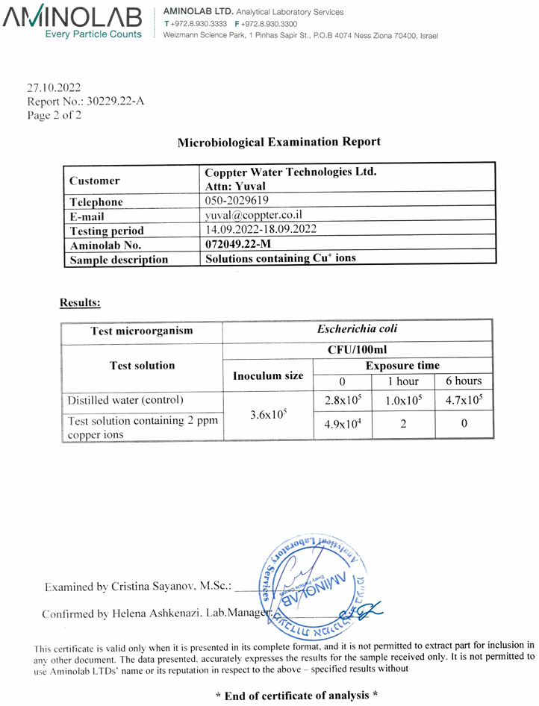
Scientific background
The bacteria and fungi that were tested and found to be sensitive to monovalent copper ions (Cu⁺)
Escherichia coli
Staphylococcus aureus
Bacillus thuringiensis
Enterobacter aerogenes
Micrococcus luteus
Staphylococcus epidermidis
Streptococcus faecalis
Pseudomonas aeruginosa
Delftia tsuruhatensis
Staphylococcus cohnii
Brevibacillus brevis
Macrophomina phaseolina
Alternaria alternata
Fusarium
Pythium
External laboratory test results

Slide 15
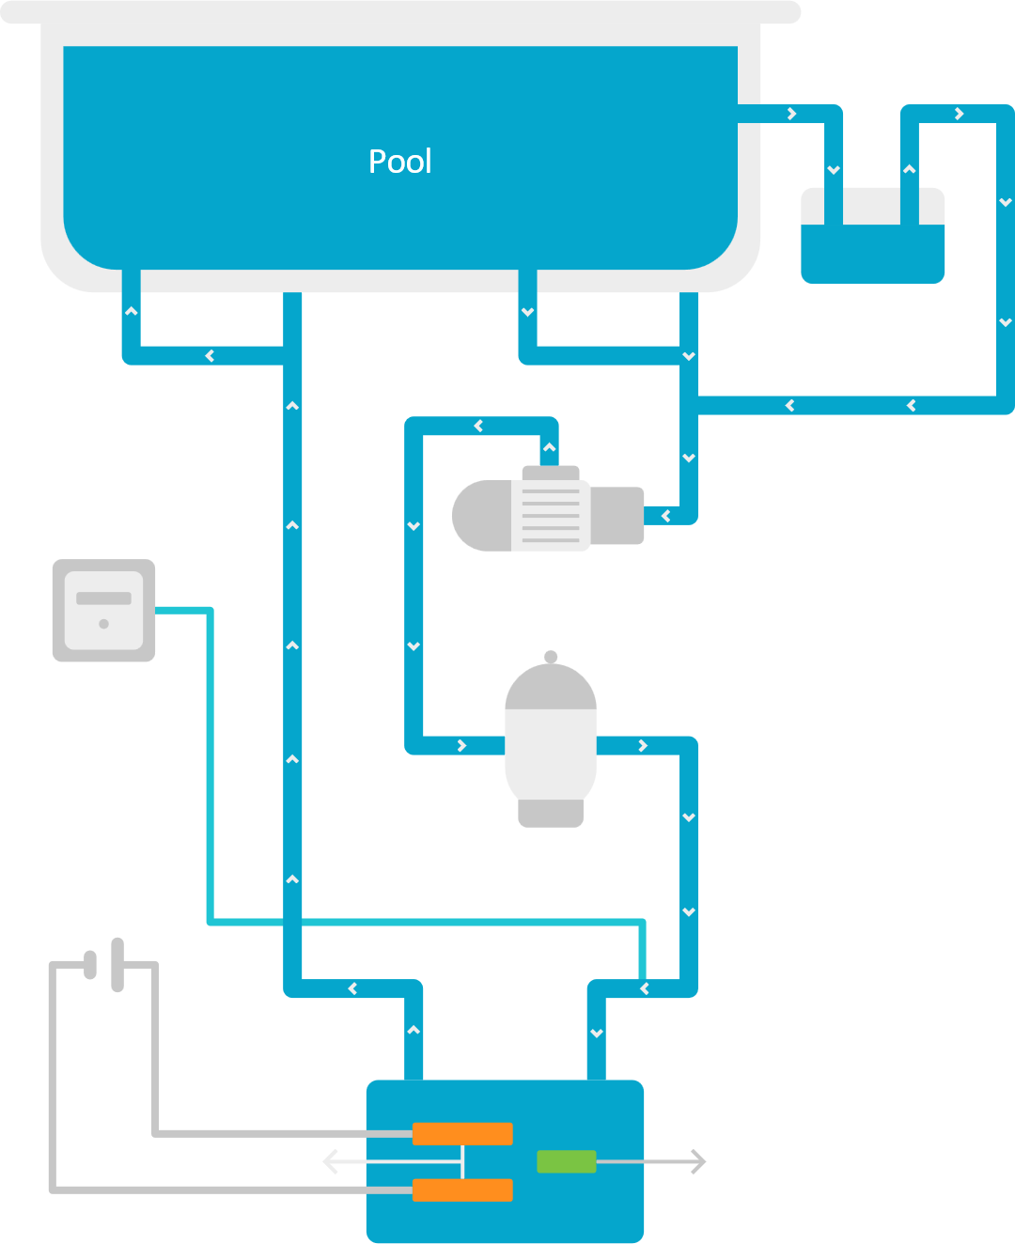

Scientific background
How It Works: Cu⁺ Generation
Pump
Control
System
Voltage
Source
Filter
Electrodes
Ion Exchange
Purification Cell

Slide 16
20000 L Alfa System with MK1 Prototype - The Results
Prototype MK1- The system works from 01/06/2023 to 25/02/2025 ~19 months
Bacteria count per milliliter (y-axis- CFU/ml) as a function of the time the pool was operated. you can see the initial introduction of bacteria into the pool and the reaching of zero bacteria in less then 30 min.

Slide 17












Current
2
Wastewater
Tertiary treatment
1
Bathing facilitates
Hot tub, mikveh Swimming pools
3
Agriculture – Fungicide
Hydroponic agriculture
Future
Industrial
cooling towers
Medical - hospital water systems
Medical - Surface/Skin disinfection
Food preservation
Food industry
Drinking water
Livestock
Aquaculture

Slide 18

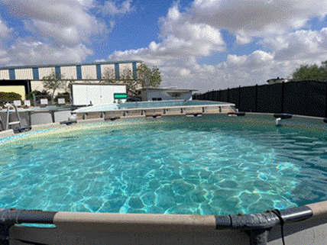


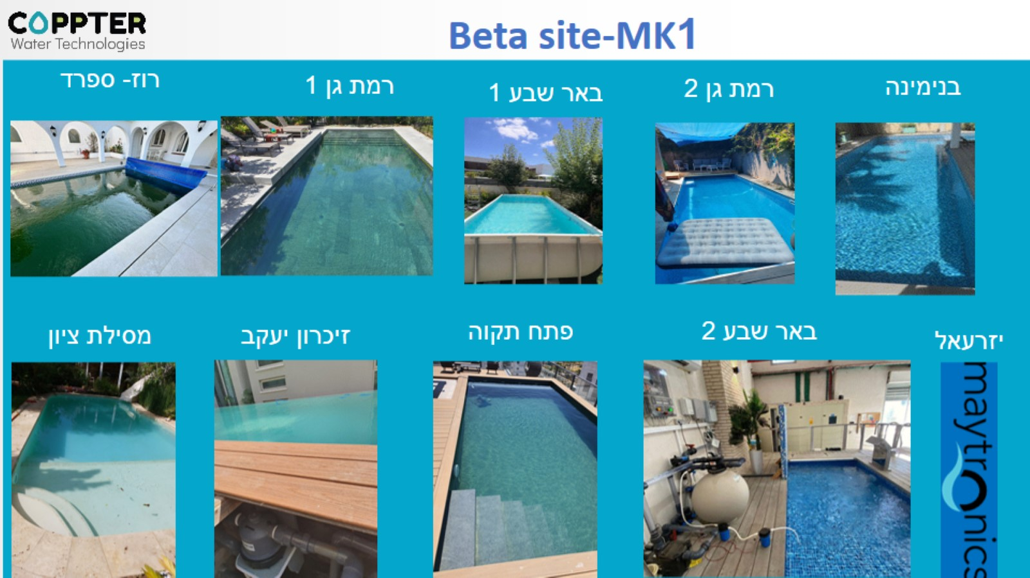
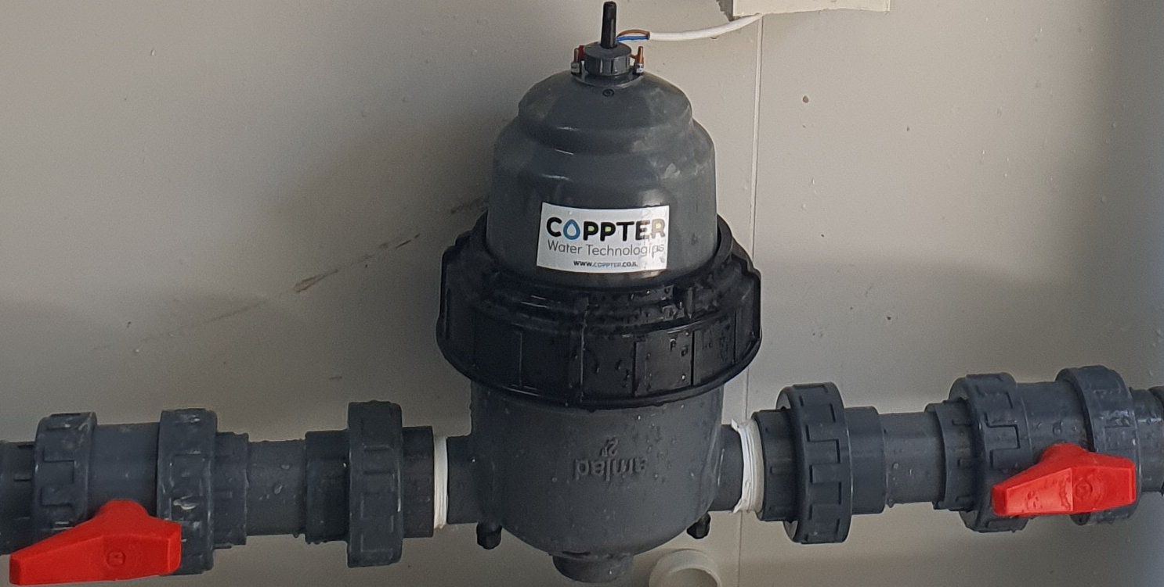
Our Journey to Innovation
From Lab to Pool
Beta system demonstrations in pools up to 250m³, with ongoing product improvements
Scaled up technology demonstration to a 20 cubic meter research pool
50L POC: Electrochemical Monovalent Copper (Cu+) Generation
2023
2024-5
To 2022

Slide 19
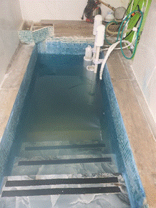
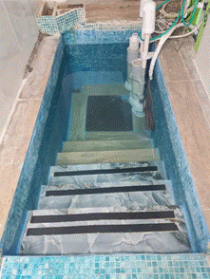
5000 L mikveh Beta site
Left - without coppter system operation, right - after coppter system operation

Slide 20

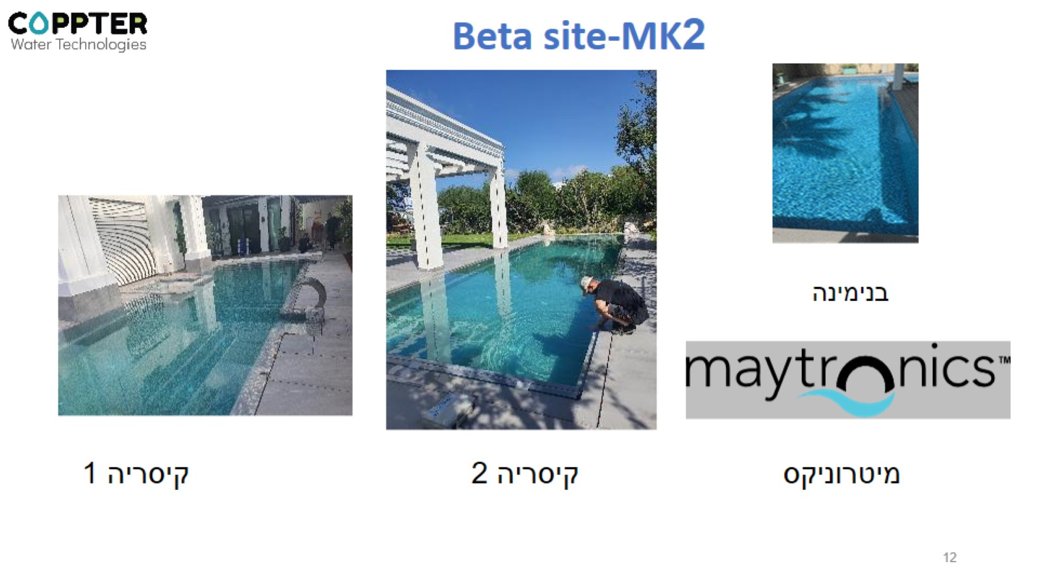
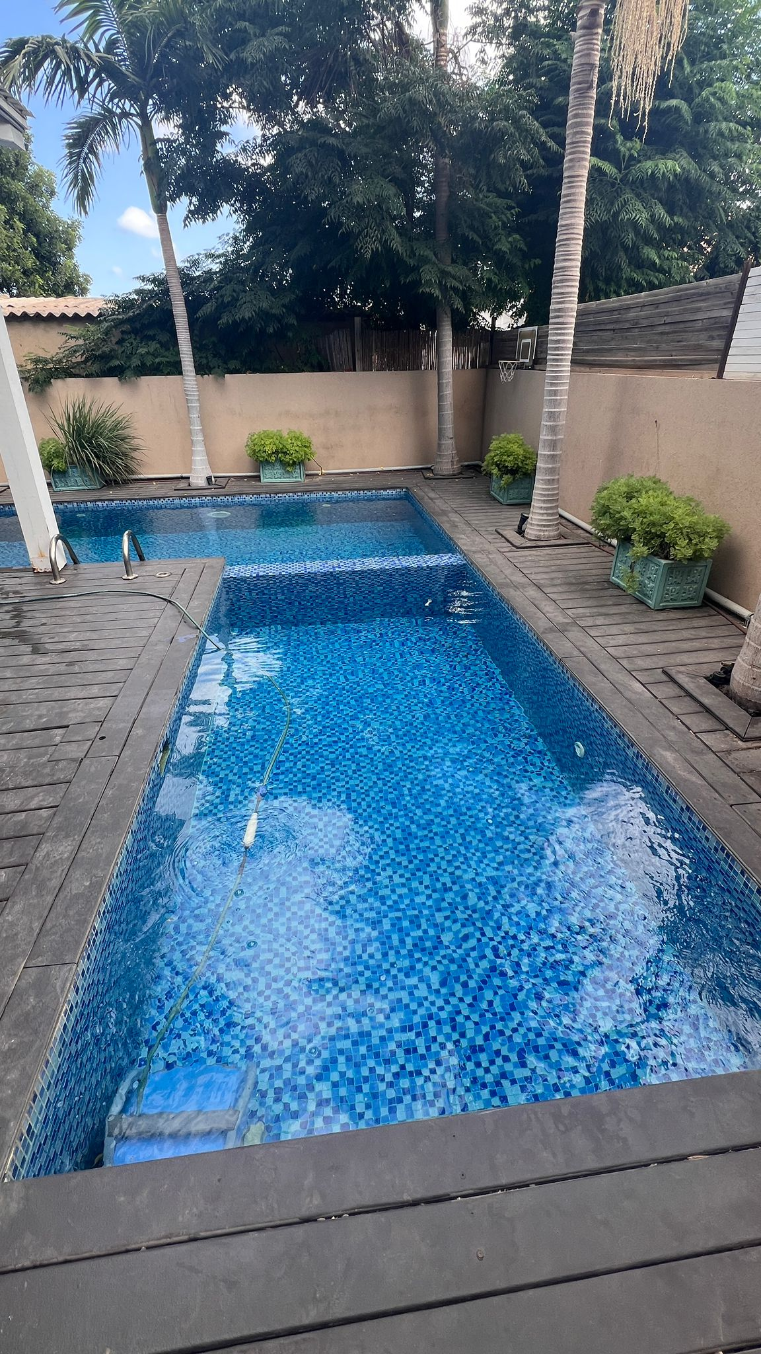
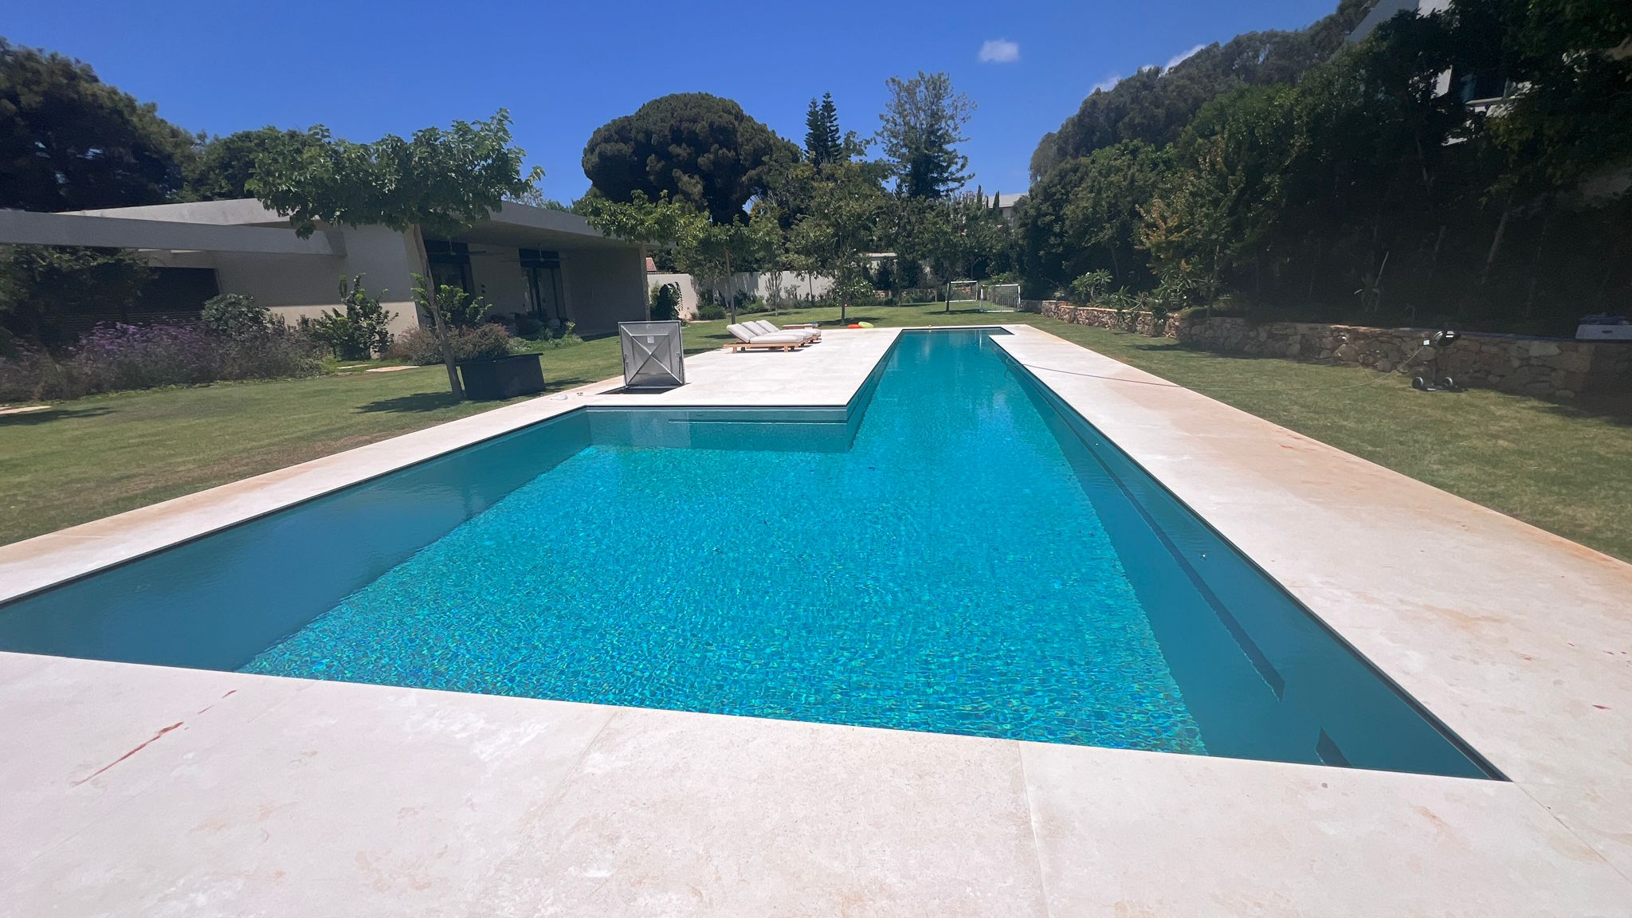
Sample of our beta sites
Binyamina
Tel Aviv
Caesarea
Roses, Catalunya

Slide 21
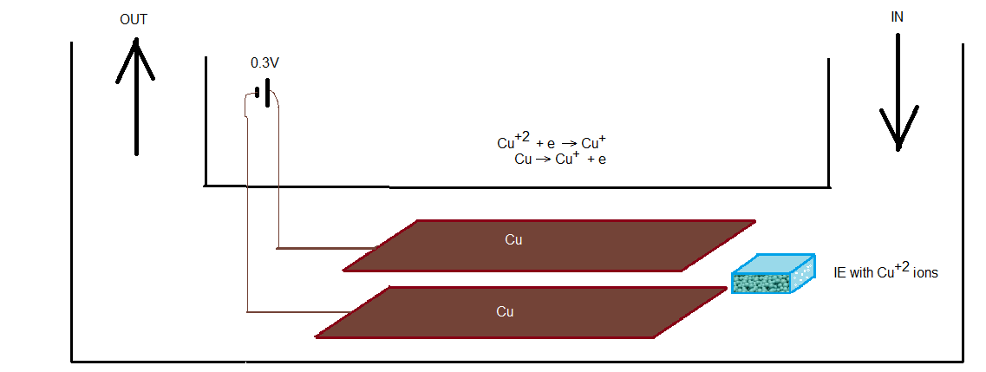
Parameters of our Water disinfection System Vs. Regulatory Standards
Conductivity (ɲs/cm) | pH | Total organic carbon TOC (ppm) | Total nitrogen TN (ppm) | Bacteria CFU/100ml | Cu ions )ppm(
500 | 7.4 | 6.5±1 | 0.3±0.03 | 0 | 0.20±0.05 | Coppter results
500-1000 | 7.5-8.5 | 25 | 10 | 10 (Pool water) | 1.3 (USA) 2 (Europe) | The standard for drinking water [*]/Pool water
*National Primary Drinking Water Regulations, Ground Water and Drinking Water. EPA. 2019-09-17. https://www.epa.gov/ground-water-and-drinking-water/national-primary-drinking-water-regulations, 2019.

Slide 22
Comparison to chlorine
 | Chlorine | Cu⁺
Acceptable concentration for disinfecting pools | 0.5ppm | 0.2ppm
Efficiency | 180min for 5 log (100000 gem/ml) redactions | 30min for 5 log (100000 gem/ml) redactions
Residuals | Yes | Yes
Stability | Over time, it evaporates from the water. | Over time, it oxidizes to Cu⁺², which is ineffective Requires recycling.
pH | Below pH 6, dangerous, emits chlorine gas Above pH 8, ineffective | No particular sensitivity to pH, activity increases with decreasing pH
Temperature | High temperature causes more evaporation | Efficiency increases with temperature
Safety | Chlorine is a dangerous substance, in high concentrations it causes health problems, as a gas it can cause death. Compounds of the reaction of chlorine with urea (found in urine) are defined as carcinogenic Chlorine is a dangerous substance, in high concentrations it causes health problems, as a gas it can cause death. | No safety problem
health | Chlorine causes dryness on the skin and burning in the eyes. Compounds of the reaction of chlorine with urea (found in urine) are defined as carcinogenic | Studies have shown that monovalent copper ions have a positive effect on the skin.
Maintenance | Need a professional to stabilize the system (chlorine, pH) | Simple maintenance, replace cartridge every 9 months

Slide 23
Comparison between Coppter technology and "copper Ionization cell"
Attribute | Coppter | Ionization cell | Advantage of a Coppter
Sores of copper ions | Cation Exchange | Ionization of metal copper | Constant concentration of copper ions
Role of the electrochemistry | Reduced Cu⁺² to Cu⁺ | Oxidation Cu⁰ to Cu⁺² | Obtaining an effective concentration of monovalent copper ions (Cu⁺)
Cell Operation | Constant voltage | Constant current | Control over an electrochemical process (not over quantity)
Oxidation state | Mostly Cu⁺ | Mostly Cu⁺² | Monovalent copper (Cu⁺) kills bacteria, divalent copper (Cu⁺²) does not.
Copper ion concentration | Constant 0.2ppm | Varies between 0.2 to 10ppm | A concentration of 0.2 PPM monovalent copper is sufficient to ensure water free of bacteria and fungi, above 10 PPM copper-colored stains may occur.
pH | Not sensitivity | Sensitive | pH sensitivity makes the system less stable
Water hardness | Not sensitivity | Sensitive | Sensitivity to Ca⁺², Mg⁺² makes the system dependent on water quality, hard water will require pre-treatment
Efficiency | Zero bacteria | Reduce bacteria population | Disinfection to zero bacteria does not require additional measures to ensure safe bathing water
Need Chlorin or Ozone add | No | In most cases | Using additional disinfectants makes the system an add-on rather than a stand-alone system.
Operating Instructions | Simple- No early stages and special actions | With early stages manual. Special actions in case of high copper concentration, changes in pH, Water hardness. | Strict prerequisites and detailed operating instructions make the system problematic to operate and unstable.

Slide 24




COMPANY’S IP
PCT patent application
No. PCT/IL2023/050025 US2024/0360011A1 titled: ”Monovalent Copper Generation System for Disinfection Water and Wastewater”
PCT patent application
No. PCT/IL2024/050587, 2024 titled: “Aqueous germicidal composition”
US Provisional patent application No. 63/767,616, 2025 titled:
“Drip irrigation system and method”
In-licensed by Coppter (Royalty free for water treatment):
“Topical Antimicrobial Formulation Containing Monovalent Copper Ions and Systems for Generating Monovalent Copper Ions for Cu+ antimicrobial use”
US11590164B2

Slide 25
Government grants
Innovation Authority 2022-24
Case number: 80342
Development of technology for chlorine-free bathing water disinfection
Meeting all objectives
Completely successfully passing a professional examination
1450 KNIS Innovation Authority
550 KNIS InNegev
Ministry of Energy 2023-24
Case number: 222-11-020
Demonstration of tertiary wastewater treatment technology at the Kibbutz Lahav Wastewater Treatment Plant
Meeting all objectives
Completely successfully passing a professional examination
600 KNIS Ministry of Energy
400 KNIS Magal Saphier

Slide 26
safety
Copper is essential to all living organisms as a trace dietary, but higher amounts of copper (30 mg/kg) are toxic.
EPA has determined that drinking water should not contain more than 1.3 mg copper per liter of water (1.3 mg/L).
Our system guarantees a concentration of below 0.2ppm copper ions

Slide 27
Summary
The active agent against bacteria is monovalent copper ions (Cu⁺), not divalent copper ions (Cu²⁺) or metallic copper (Cu⁰).
The mechanism involves the entry of the monovalent copper ion (Cu⁺) into the bacterial cytoplasm and the inactivation of enzymes essential for its life.
Using an electrochemical system and water circulation, an effective dynamic concentration of monovalent copper ions can be maintained in water (exposed to air)
A concentration of 0.2ppm copper ions is sufficient in the above system to disinfect the water from bacteria and fungi completely.

