Slide 1


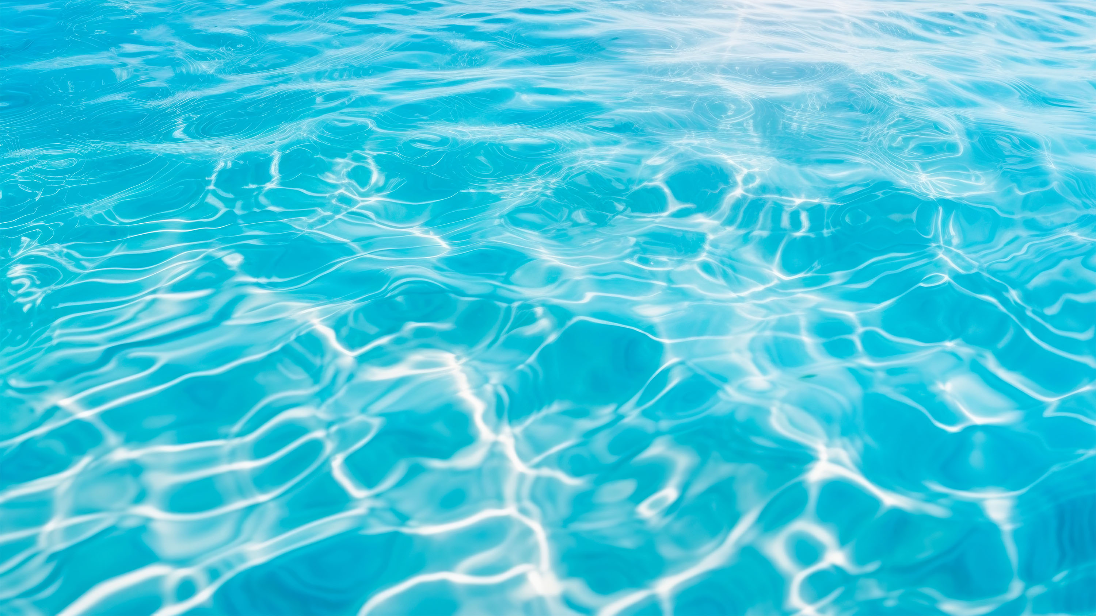

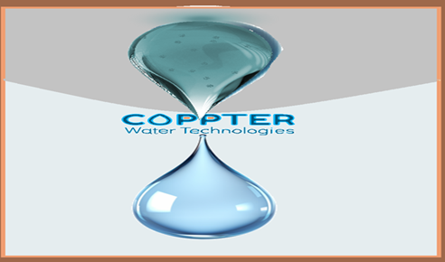

Wastewater & reservoir
A new era
of environmentally friendly& chlorine-free Safe Water
www.coppter.co.il
magal@coppter.co.il

Slide 2



Main disinfection agent - Chlorine
CHLORINE - A SERIOUS HAZARD

Slide 3
The Holy Grail - Chlorine-Free Bathwater
Chlorine, as a purification agent, has been used for Bathwater treatment since the early 1900s
Consumers are seeking an effective alternative
Water Disinfection Treatments

Slide 4

Coppter developed a safe water treatment
using a unique form of copper (Cu⁺)
as a disinfectant

Slide 5
Copper :
Since the dawn of time, mankind has been using various copper phase to prevent various infections caused by a wide array of harmful microorganisms. Nowadays it’s not a common in antimicrobial products. Perhaps because of the absence of repeatability of its effect.
Our research has shown that the only form of copper (Cu) to have the desirable effect is monovalent copper (Cu⁺) and furthermore that it can be continuously generated by alternation of the local conditions of the site, thus allowing us to achieve a vigorous repeatable effect*.
Magal saphier, Eldad Silberstein, Yoram Shotland, Stanislav Popov and Oshra Saphier, "Prevalence of Monovalent Copper Over Divalent in Killing Escherichia coli and Staphylococcus aureus" Current Microbiology, https://doi.org/10.1007/s00284-017-1398-4, 2017
Stanislav Popov, Oshra Saphier, Mary Popov, Marina Shenker, Semion Entus, Yoram Shotland and Magal Saphier; "Factors Enhancing the Antibacterial Efect of Monovalent Copper Ions", Current Microbiology, December 2019,p 1-8 , https://link.springer.com/article/10.1007/s00284-019-01794-6 2019.

Slide 6
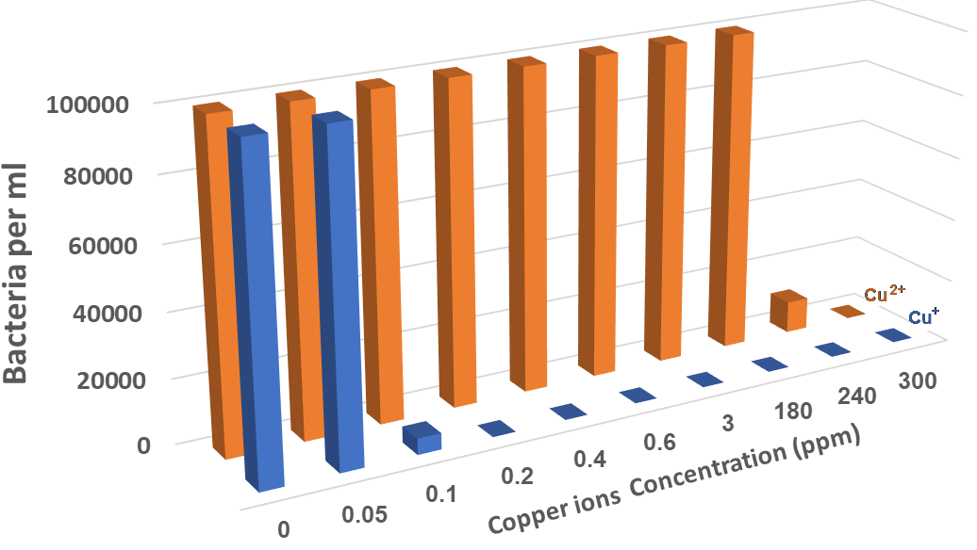
COPPTER’S TECHNOLOGY
Cu regulation in drinking water:
Europe: up to 2 PPM
The US: up to 1.4 PPM
Safe water treatment using a unique form of copper ion (Cu⁺) In low concentrations of 0.2 PPM as a disinfectant
While
You need to use over 300 PPM of Cu ²⁺ to have the same effect!

Slide 7
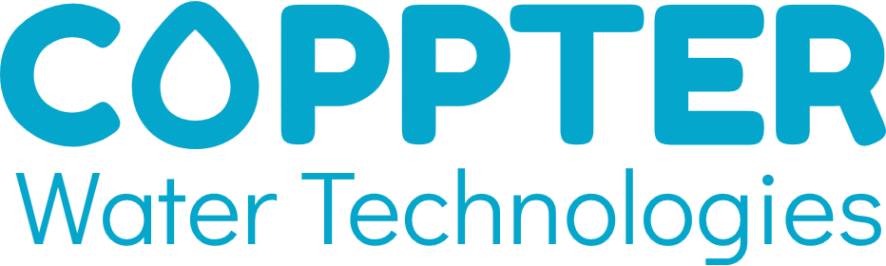











Current
2
Wastewater
Tertiary treatment
1
Bathing facilitates
Hot tub, mikveh Swimming pools
3
Agriculture – Fungicide
Hydroponic agriculture
Future
Industrial
cooling towers
Medical - hospital water systems
Medical - Surface/Skin disinfection
Food preservation
Food industry
Drinking water
Livestock
Aquaculture

Slide 8



WASTEWATER TREATMENT
1
Primary treatment
Wastewater
Grit removal
Primary clarification
Sludge
2
Secondary treatment
Bio-reactor
Secondary clarification
Screening
Sludge
3
Tertiary
treatment
Secondary effluent
Disinfection
Water that is safe for use

Slide 9






MARKET AND COMPETITORS
Global wastewater treatment
equipment market (2023):
Chlorine
Toxic, Causing earth salination
Membrane Filtration (MF & UF)
Expensive, High Energy
UV
Expensive, High Energy
Ozonation
Expensive, High Energy
32.77 Billion USD
Salt Chlorinators
Expensive, safety / environmental damage
(release Chlorine)

Slide 10

COPPTER VS. COMPETITORS
Wastewater
Tertiary treatment
For 100 m³ per day
Chlorine
UV
Ozonation
Coppter Cu+
Price
3,000$
12,000$
17,000$
9,100$
Energy consumption
0.2 KWh
8 KWh
6 KWh
3 KWh
Annual operation cost
4K$
11K$
8K$
1.9K$
Operation safety
Toxic
Ultraviolet radiation
Toxic
Safe
Toxic residuals
Yes
No
Yes
No

Slide 11


Government grants
Innovation Authority 2022-24
Case number: 80342
Development of technology for chlorine-free bathing water disinfection
Meeting all objectives
Completely successfully passing a professional examination
1450 KNIS Innovation Authority
550 KNIS InNegev
Ministry of Energy 2023-24
Case number: 222-11-020
Demonstration of tertiary wastewater treatment technology at the Kibbutz Lahav Wastewater Treatment Plant
Meeting all objectives
Completely successfully passing a professional examination
600 KNIS Ministry of Energy
400 KNIS Magal Saphier

Slide 12
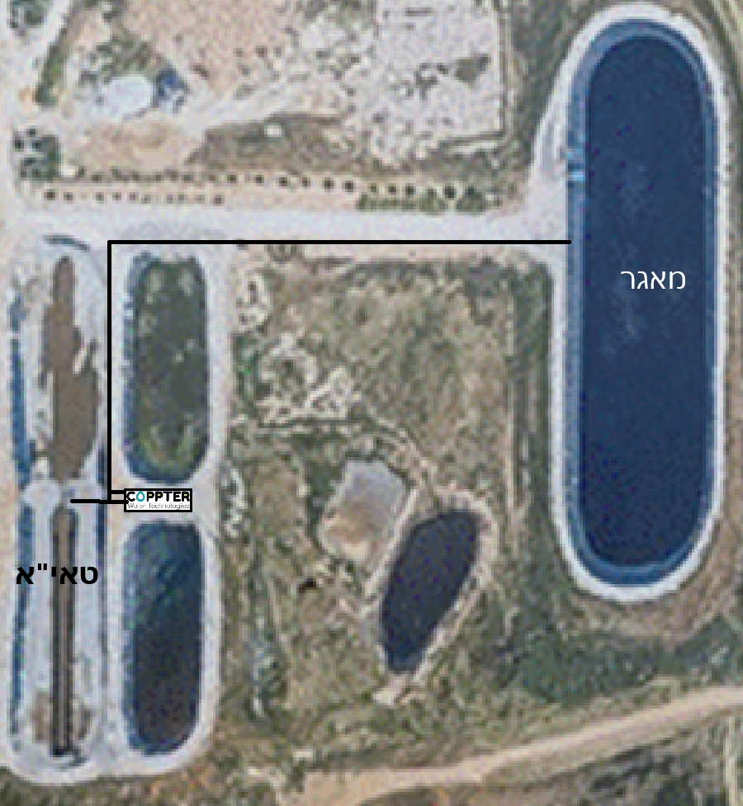
Copter facility at the Kibbutz Lahav wastewater treatment center
From the aerobic-anoxic treatment carried out in the Taya system, the effluent is transferred to the Coppter facility and from there discharged into the reservoir.
The facility has a total volume of 16 cubic meters, contains 3 circulation pumps and 3 disinfection systems.
The treated volume is approximately 20 cubic meters per day
reservoir
Secondary treatment

Slide 13

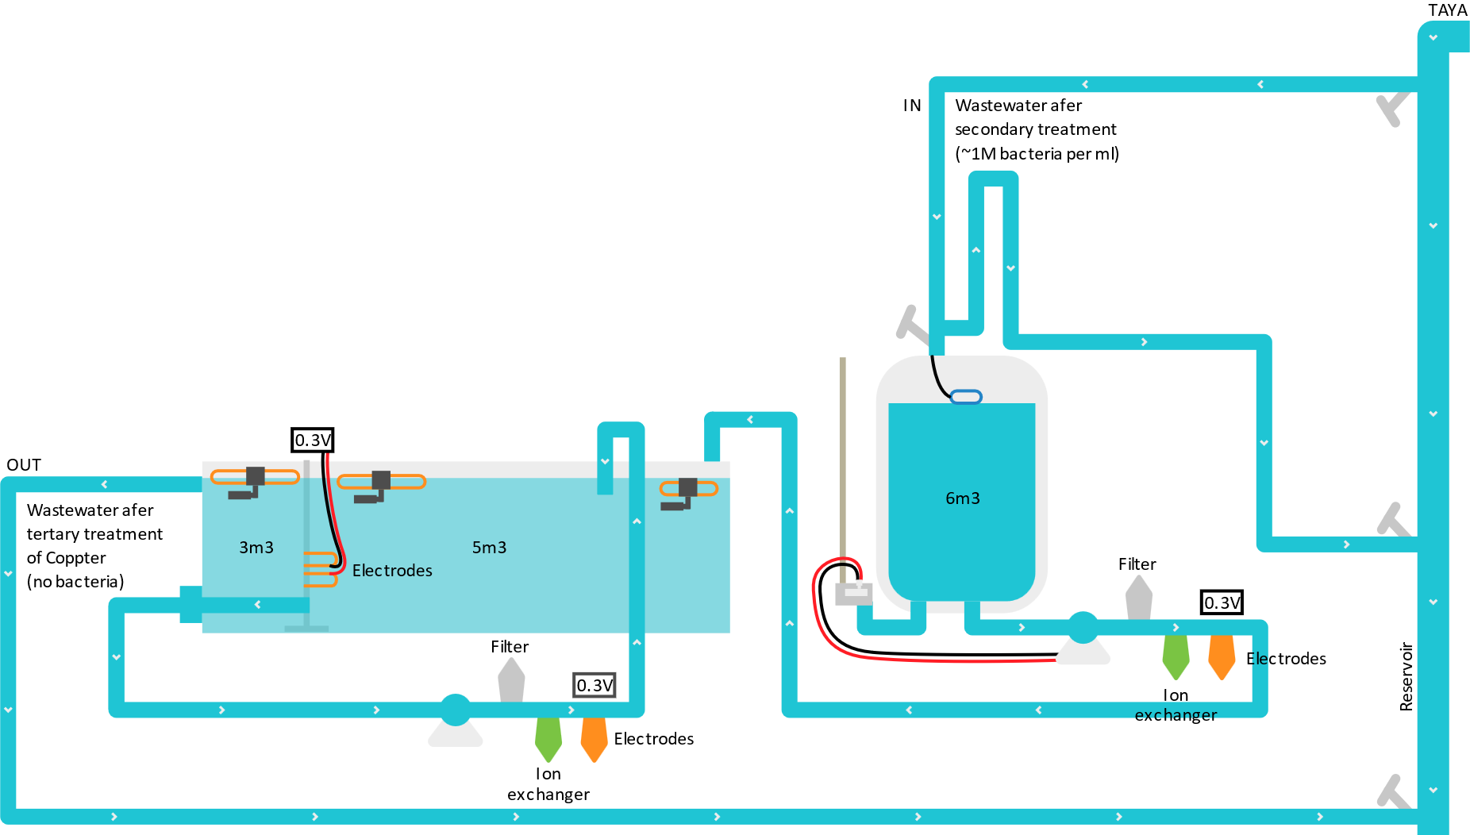
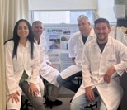
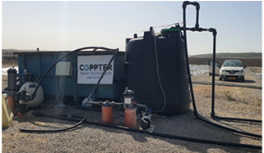
WASTEWATER TREATMENT
COPPTER’S COP10 SYSTEM BENEFITS
No earth salination
Lower operation costs
Lower device price
No toxic residues
Lower energy consumption

Slide 14
WASTEWATER TERTIARY TREATMENT
COPPTER’S LAHAV WWPT 1 YEAR PILOT RESULTS
(Flow= 20 m³/day)
Bacteria per ml
MAXIMAL | MINIMAL | AVERAGE
1,000,000 | 10,000 | 100,000 | In
1000 | 10 | 100 | Inside
100 | 1 | 15 | Out
Cu ions: 0.2-0.3 PPM
Cost (Building + Operation) : $0.12/m³ vs. $0.16-0.18/m³ in Ozonation and UV
Energy consumption calculated for 100m³/day plant: 3KWhr/m³

Slide 15
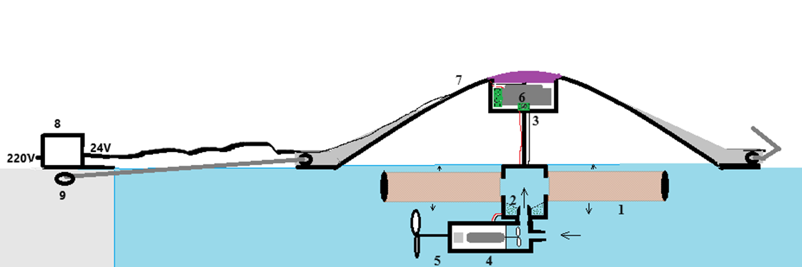
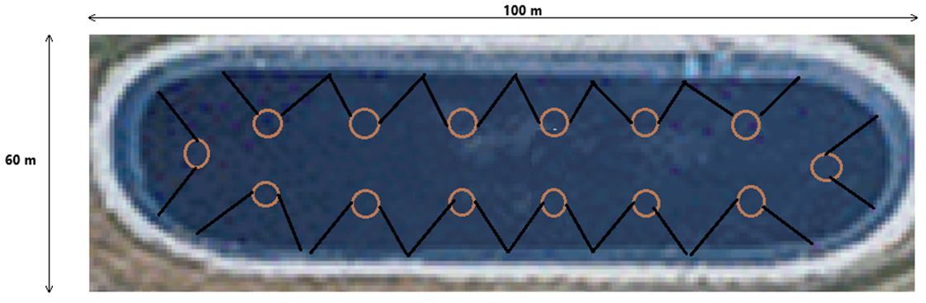
WASTEWATER TERTIARY TREATMENT
Conclusions:
Good preliminary results but might be better to treat the reservoir
COP11 floating system
reservoir
Secondary treatment

Slide 16


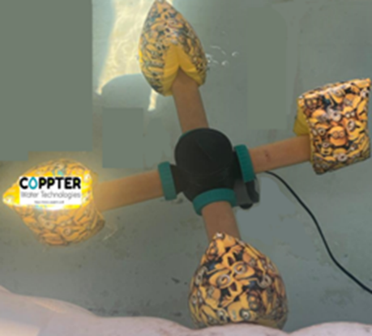
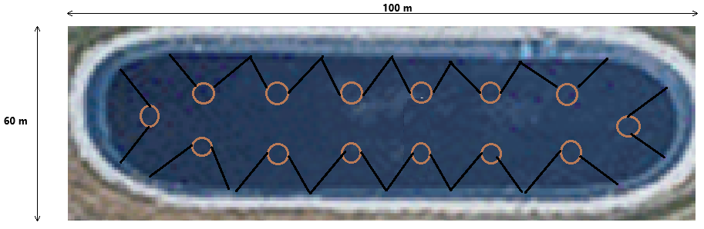
Proposed system for the prevention and disinfection of microorganisms to reduce environmental contamination in open water reservoirs, including wastewater reservoirs that have been treated with secondary treatment only or with inadequate tertiary treatment.
‚

Slide 17


COMPANY’S IP
PCT patent application
No. PCT/IL2023/050025 US2024/0360011A1 titled: ”Monovalent Copper Generation System for Disinfection Water and Wastewater”
PCT patent application
No. PCT/IL2024/050587, 2024 titled: “Aqueous germicidal composition”
US Provisional patent application No. 63/767,616, 2025 titled:
“Drip irrigation system and method”
In-licensed by Coppter (Royalty free for water treatment):
“Topical Antimicrobial Formulation Containing Monovalent Copper Ions and Systems for Generating Monovalent Copper Ions for Cu+ antimicrobial use”
US11590164B2

Slide 18
safety
EPA has determined that drinking water should not contain more than 1.3 mg copper per liter of water (1.3 mg/L).
Concentration (strict) permitted for disposal as wastewater - 0.2ppm Cu ions
Our system guarantees a concentration of below 0.2ppm copper ions

Slide 19
Summary
Coppter technology may bring good news for wastewater treatment.
Water that is free of pathogens and suitable for agriculture, including growing vegetables.
No chlorine, and no salt.
Stable and easy to maintain system
Eco-friendly
Cost-effective

