Slide 1


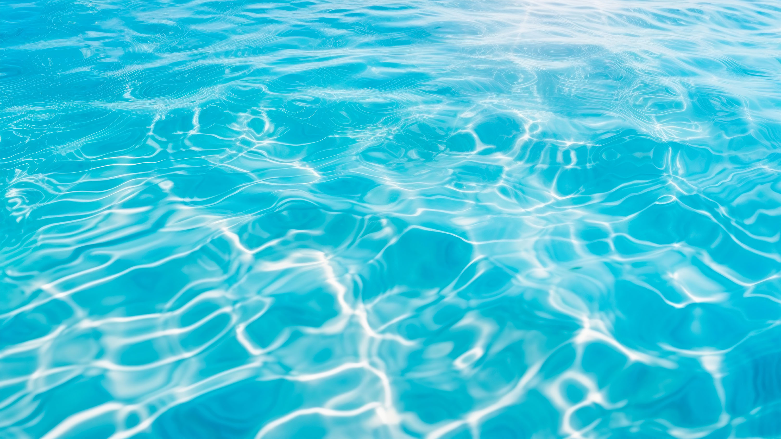

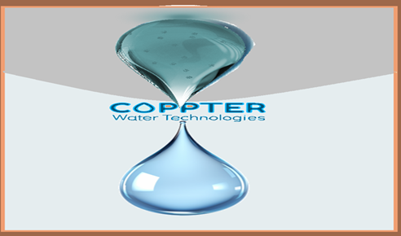

Agriculture
A new era
of environmentally friendly& chlorine-free Safe Water
www.coppter.co.il
magal@coppter.co.il

Slide 2













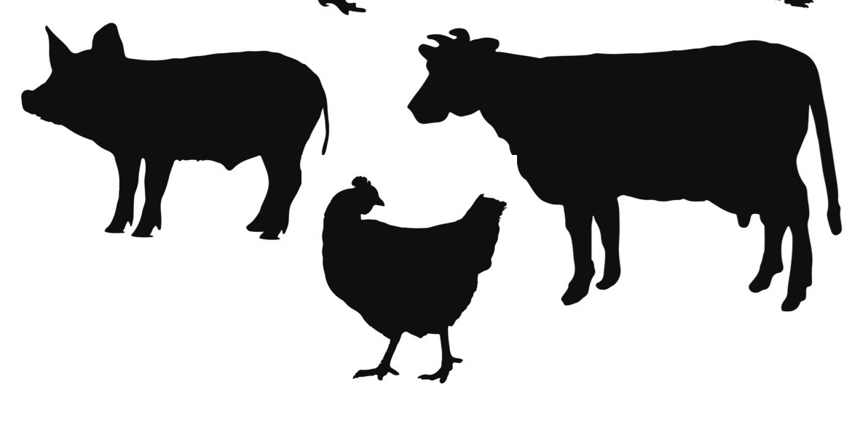
Current
2
Wastewater
Tertiary treatment
1
Bathing facilitates
Swimming pools
Hot tub, mikveh
3
Agriculture – Fungicide
Hydroponic agriculture
Future
Industrial
cooling towers
Medical - hospital water systems
Medical - Surface/Skin disinfection
Food preservation
Food industry
Drinking water
Livestock
Aquaculture

Slide 3

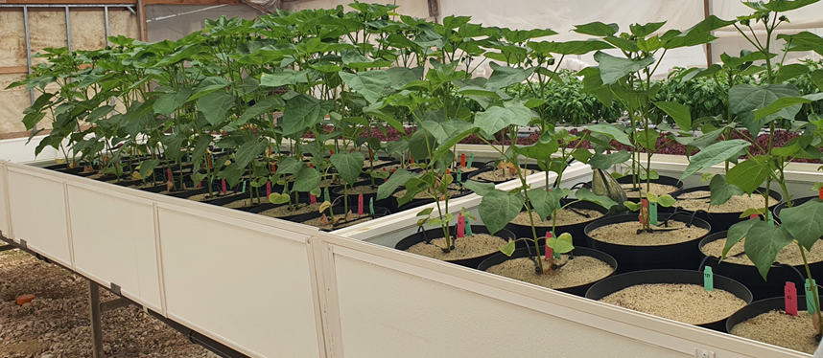
Use as Fungicide
Against Macrophomina
Soybean, Cotton, sesame
Coppter Without Coppter
The experiment was carried out by Phenoroot Ltd at the request of Coppter (2023)
Contact: Dr. Gadi Peleg Email: gadi@phenoroot.com

Slide 4
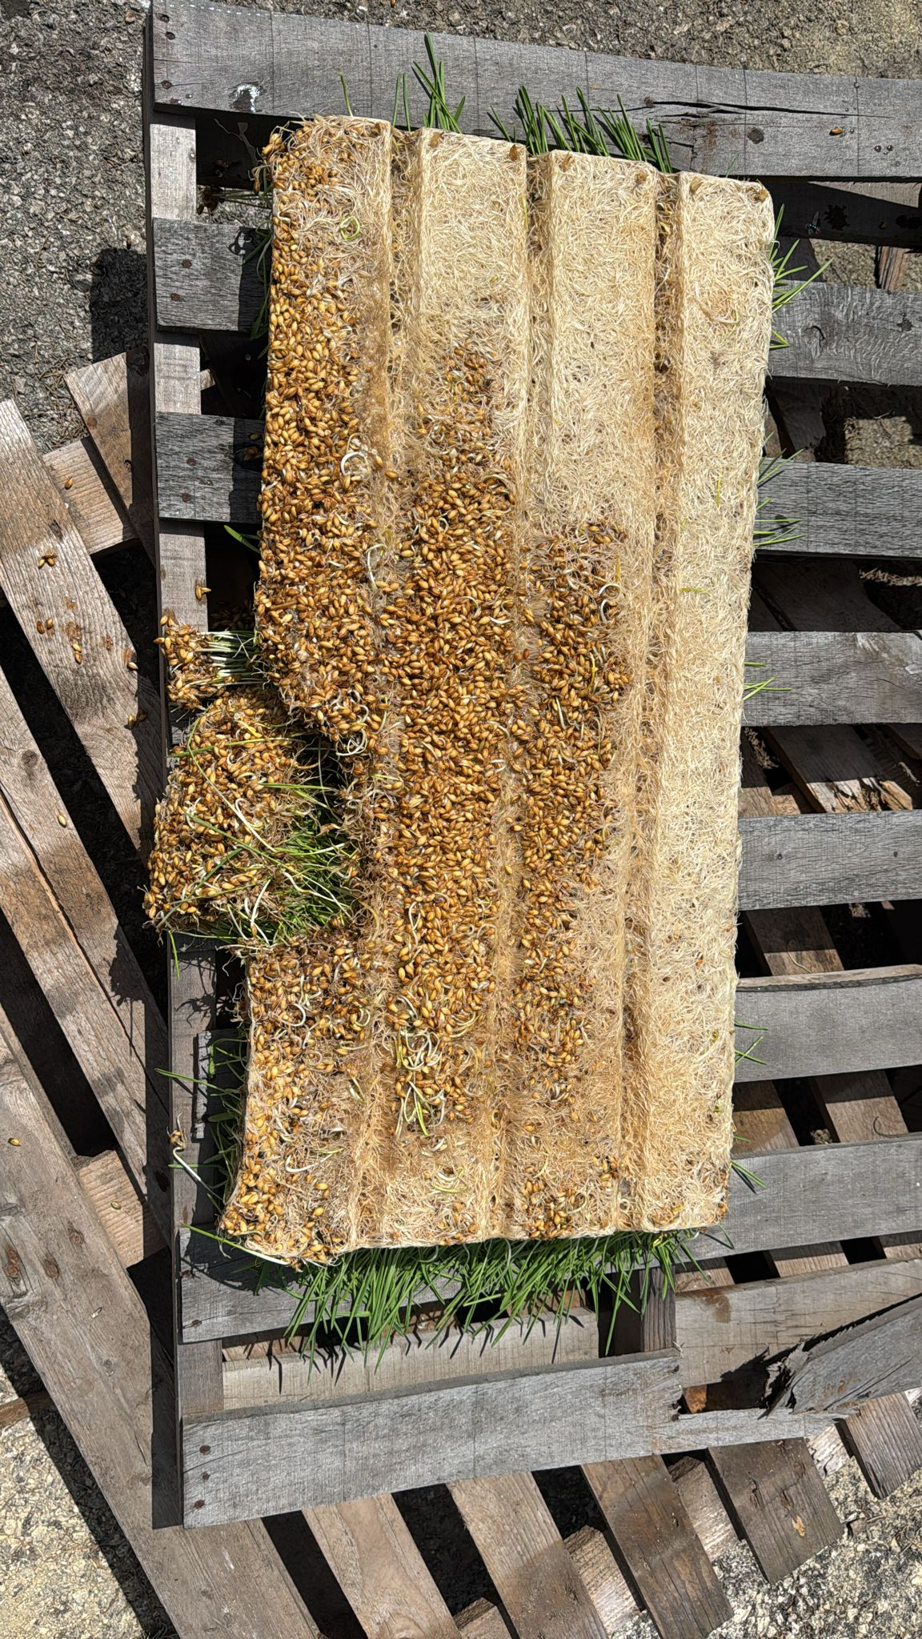
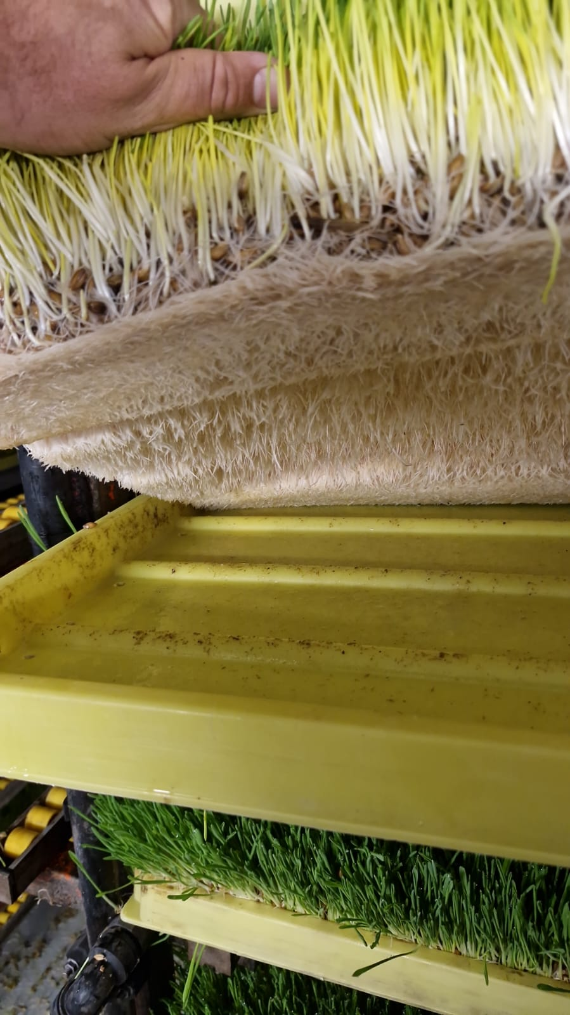
Use against fungal pathogens in
Air-roponic Agriculture
Before Coppter
The experiment was carried out with “Hoshen Foodtech” Ltd
(2024)

Slide 5
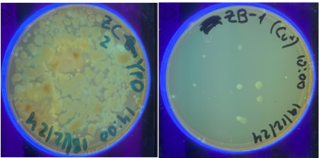

Use against fungi pathogens in Ground disconnected Agriculture
Fungi in the soil of the saffron crop
Before Coppter
The experiment was carried out with “Saffron Tech” Ltd (2024)

Slide 6
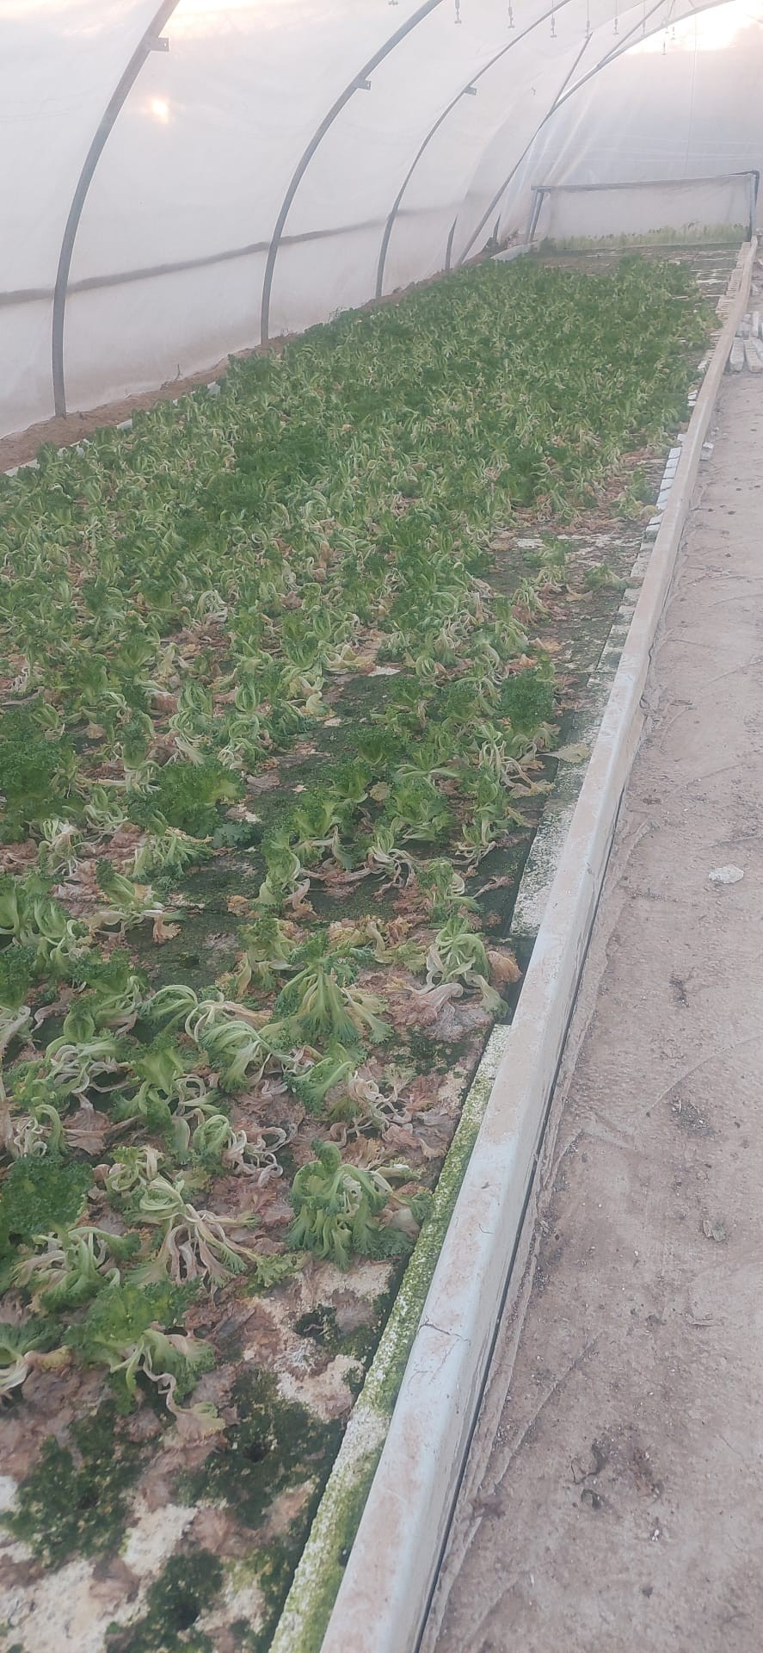
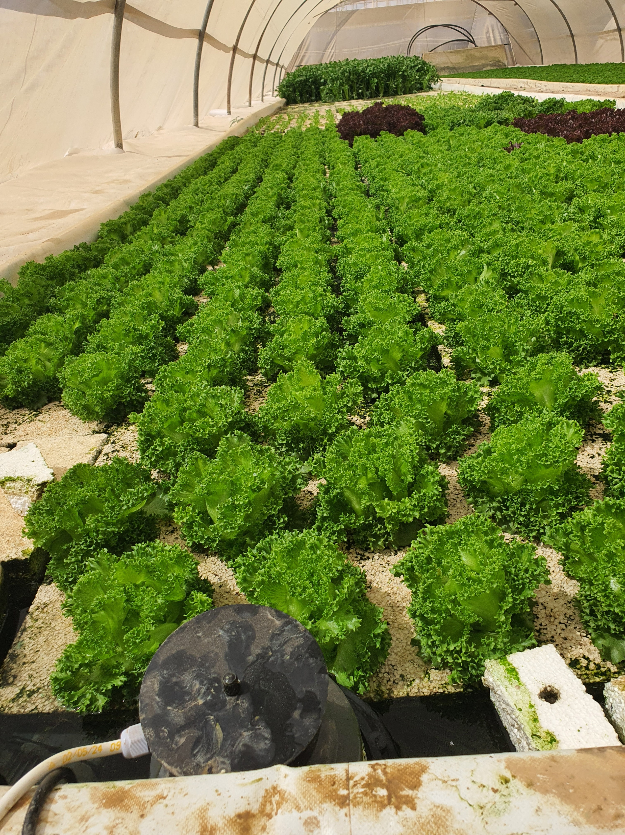
Hydroponic Agriculture
Before (Pythium infection) Coppter

Slide 7
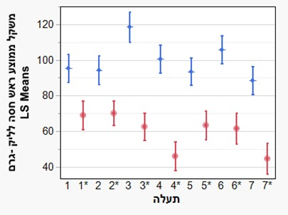
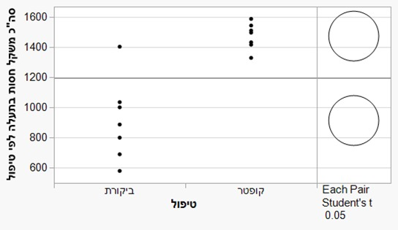
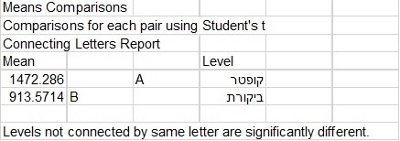
Hydroponic Agriculture: Testing the technology by an agricultural consultant at different sites and three growing cycles
Average weight of a head of lettuce, grams
Weight of a the lettuce in Growth canal
Growth canal
Control
Coppter
Coppter
Control

Slide 8

prevents the penetration of roots into the pipeline located deep in the soil.
Diagram showing percentage of root penetration into the pipeline for irrigation water without treatment compared to irrigation water with 0.2ppm monovalent copper ions
The experiment was carried out with “Netafim” Ltd (2022-3)

Slide 9
Disinfectant Solution Containing Monovalent Copper Ions
Use of monovalent copper ions for disinfecting food from bacteria and extending shelf life

Slide 10
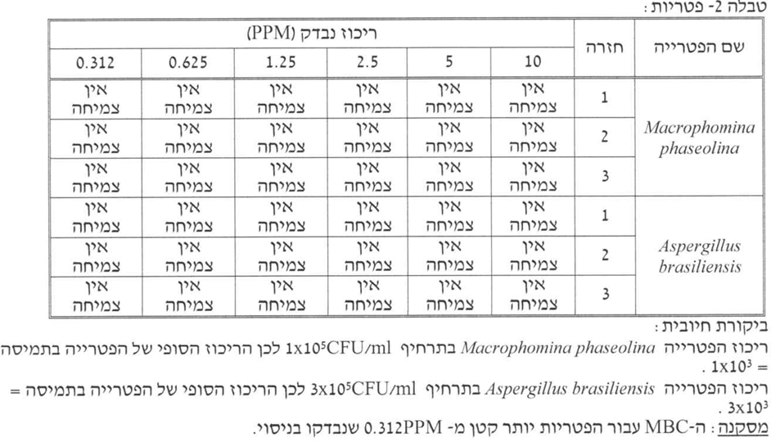

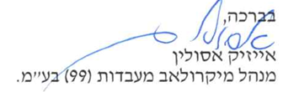
External laboratory test results
Cu⁺ ions Concentration in ppm
No growth
No growth
No growth
No growth
No growth
No growth
In addition, Fusarium and Pythium Fungi were found to be sensitive to monovalent copper ions.

Slide 11
safety
Copper is essential to all living organisms as a trace dietary, but higher amounts of copper (30 mg/kg) are toxic.
EPA has determined that drinking water should not contain more than 1.3 mg copper per liter of water (1.3 mg/L).
Our system guarantees a concentration of below 0.2ppm copper ions

Slide 12
Summary
Coppter technology may bring good news to agriculture.
Enable aeroponics and hydroponics crops without fear of pathogens, thus enabling advanced agriculture that is economical in terms of water, space, manpower, and more.
Allow the use of drip piping underground without fear of root penetration and the formation of biofilms.
Avoid the use of oxidizing agents, chlorine, hydrogen peroxide, ozone, antibiotic, and antifungal chemicals.

